Slide 1

UNIVERSITY INSTITUTE OF COMPUTING
Agile Methodology
(24CAT-656)

Slide 2
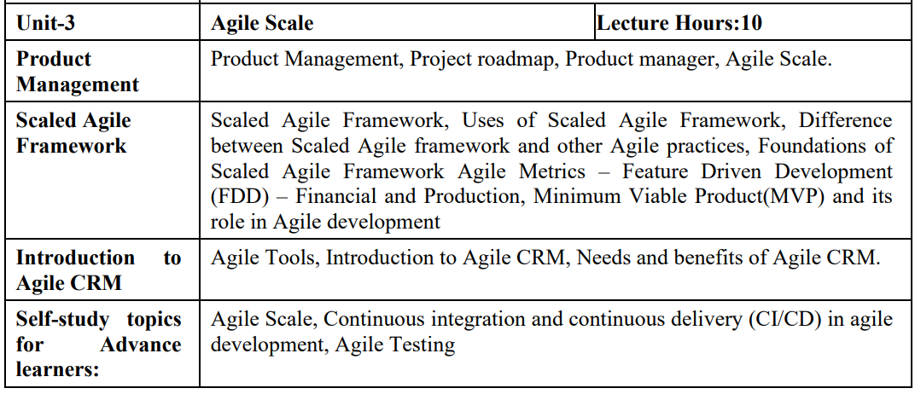
SYLLABUS
2

Slide 3
CONTENT OF THE SYLLABUS
TEXT BOOKS
T1 David J. Anderson and Eli Schragenheim, Agile Management for Software Engineering: Applying the Theory of Constraints for Business Results, Prentice Hall, 2003.
T2 Hazza and Dubinsky, Agile Software Engineering, Series: Undergraduate Topics in Computer Science, Springer, 2009.
T3 Agile Software Development Ecosystems by Jim Highsmith, Addison-Wesley 2002, ISBN 0201760436.
REFERENCES
R1 Craig Larman, Agile and Iterative Development: A Managers Guide, Addison-Wesley, 2004.
R2 Kevin C. Desouza, Agile Information Systems: Conceptualization, Construction, and Management, Butterworth-Heinemann, 2007.
3

Slide 4
Product Manager
Product Management is responsible for defining and supporting the building of desirable, feasible, viable, and sustainable products that meet customer needs over the product-market lifecycle.
SAFe defines two kinds of customers: Internal and External. Each is described next. Internal customers are part of the enterprise. An example would be the manager of a bank’s credit underwriting function who uses an internal credit scoring solution created by the internal IT department. Because internal solutions often support many operational value streams, there may be several internal product managers
4

Slide 5
Product Manager
. Internal Product Managers External customers are outside the enterprise. The relationship between the enterprise and external customers takes many forms: Business-to-Business (B2B), such as an enterprise software vendor providing a payroll solution Business-to-Professional (B2P), such as a software vendor who sells graphic design tools to marketing professionals Business-to-Consumer (B2C), such as a software vendor that sells home design tools to homeowners
5

Slide 6
Product Manager
Product management responsibilities Each of these is described further below. Extended responsibilities associated with external product managers and Solution Trains are described later. Meet Business Goals An economically sustainable product creates more value than it costs. However, although costs are relatively straightforward to measure, there’s more variation in how an enterprise assesses value.

Slide 7
Scaled Agile
Agile wasn’t originally conceived with scale in mind. The goal was unschackling developers and engineers, empowering them to tackle implementation independently using their own best judgment, incorporating learnings from one iteration into the next.
That unfettered independence doesn’t work as well when there are multiple teams off doing their own thing, particularly when their individual projects must interoperate, share a common interface, rely on a shared architecture, etc. Things can quickly escalate into a free-for-all.
7

Slide 8
Scaled Agile
Therefore, leveraging the advantages of Agile while recognizing the need for coordination and compatibility demands more structure, organization, and oversight. Agile at scale must have more rules and controls to ensure the finished product not only functions but works seamlessly across various sub-components, and that product suites look and act like they were built by the same company.
The various Microsoft Office apps, for example, all perform their individual functions well, but what makes the suite even more successful is how seamlessly users can move from one program to the next with a limited learning curve thanks to a common UX. If the Word team and the Excel team operated 100% independently, it wouldn’t be long until each one behaved quite differently.
8

Slide 9
Scaled Agile
Scaled Agile provides that layer of management and coordination to build complex solutions that are too big and complicated for a single Scrum team to tackle. This may be driven by urgency to get a solution to market, or simply because the product itself is too large and sophisticated.
Scaled Agile also creates a more predictable release schedule. Because of the coordination required, it’s clearer when certain projects, products, components, and features will ship, enabling enterprise software companies to make customer commitments and line up sales, marketing, operations, and customer service to support these launches.
9

Slide 10
Scale a Product Manager
1 Involve the Right People : A small group of qualified individuals who have the right skills and motivation can be more productive than many individuals who lack the necessary expertise and act out of obligation. This is true for product people and development team members alike in my experience.
2 Don’t Scale Prematurely: Rather than scaling prematurely, stay as small as you possibly can until you are getting close to reaching product-market fit. This allows you to quickly respond to market feedback, experiment with new ideas, and make any architecture and technology changes that may be required in order to move into the growth stage.
10

Slide 11
THANK YOU
For Queries:- ramanjeetsingh.uic@cumail.in

